Slide 1
FINAL PROJECT REPORT
Whiteboard Platform
Class: NT106.M21.ANTN
Subject: Basic Network Programming
Instructor: Ms. Do Thi Huong Lan
Team 7:
Vo Quang Minh - 20520248
Nguyen Dang Nguyen – 20520256
Tran Bao An - 20520377

Slide 2
TABLE OF CONTENTS
General
Analysis and Design
Features and Technology
Implementation and Testing

Slide 3
GENERAL
Goal: a platform that can help student and teacher communication easily
Knowledge: Socket programming, Graphic coding via C# and Python
Application:
Education: setup classrooms, teamwork space, online discussion
Company: meeting online, teamwork space, brain storming space
Hand out with friends: features to support organize drawing together game, chatting

Slide 4
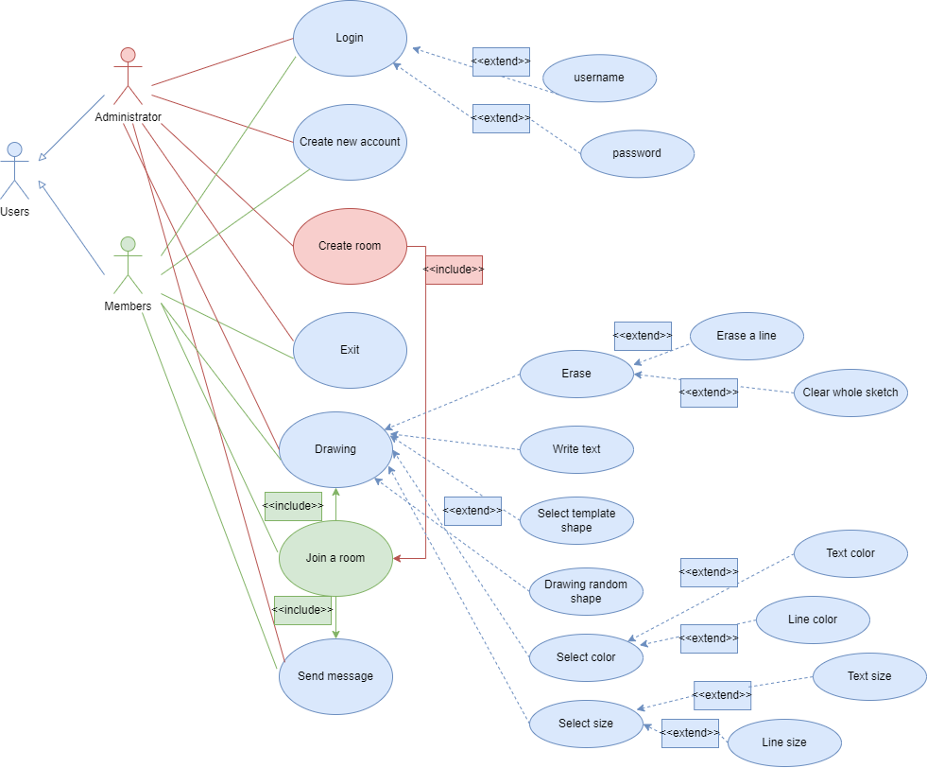
ANALYSIS AND DESIGN
Usecase Diagram

Slide 5
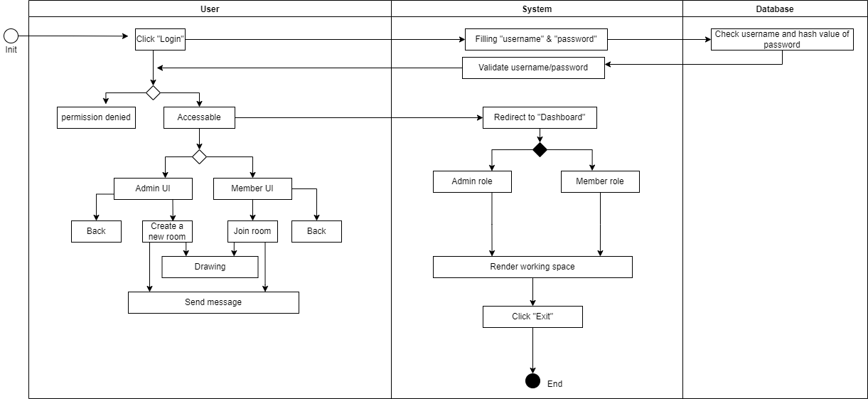
Activity Diagram

Slide 6
LIST OF FEATURES
No. | Feature | Sub-Feature
 | Login
 | Create account
 | Store users' data to database
 | Encrypt password to ensure security
 | Drawing features
 | Local | Choose color
 |  | Choose shape templates: Ellipse, Rectangle, Line
 |  | Write text
 |  | Resize line's size
 |  | Choose font
 |  | Resize text
 |  | Erase specific line
 |  | Erase whole sketch
 |  | Save to file
 |  | Click to see guide
 |  | Broadcast sketch to other members
 |  | Broadcast message to other members
 |  | Distinguish text message and bitmap message

Slide 7
FEATURES AND TECHNOLOGY
Technology
Client: language: C# Winform (.NET Framework)
Server: language: Python
Details
Protocol: TCP
Library: System.Drawing.Imaging & System.Net.Sockets;
I/O:
network stream: text message, bitmap message
file stream: save sketch to file image
Cryptography: Encrypt password before sending to server: using SHA-256
Database: Excel: Connect to database to store users’ data and verify account
Using multi threading and asynchronous rendering to handle data (string and bitmap)
Multi Client: more than one client can join one room
Demo via LAN: later
Demo via Internet: later

Slide 8
IMPLEMENTATION & TESTING
Development environment
Operating system: Window 11
Database: Excel
Text Editor: Visual Studio Code
Language: Client: C#, Server: Python
Deployment environment: Local and Internet

Slide 9
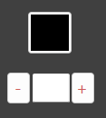
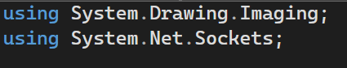
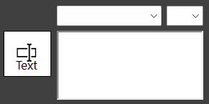
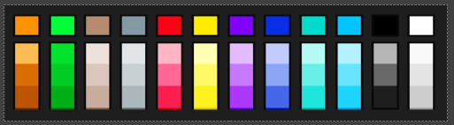
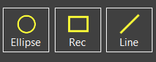
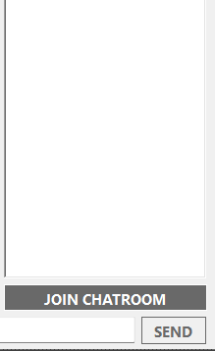
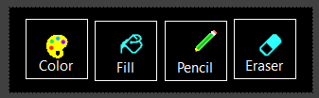
IMPLEMENTATION & TESTING: CLIENT SIDE
Line size
App Logic
Drawing text
Pick a color
Template shape
(detect real or fake action)
Chat session
Drawing tool

Slide 10
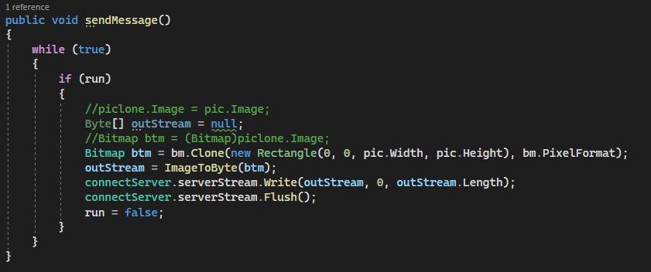
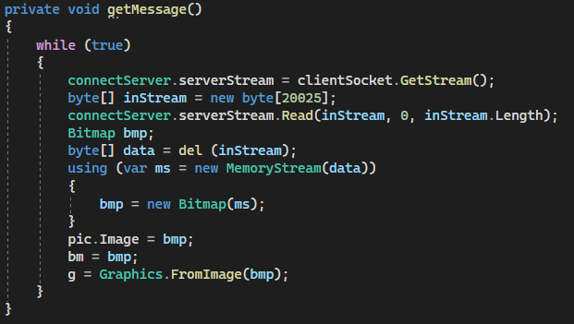
IMPLEMENTATION & TESTING: CLIENT SIDE
Socket logic

Slide 11
IMPLEMENTATION & TESTING: SERVER SIDE

Slide 12
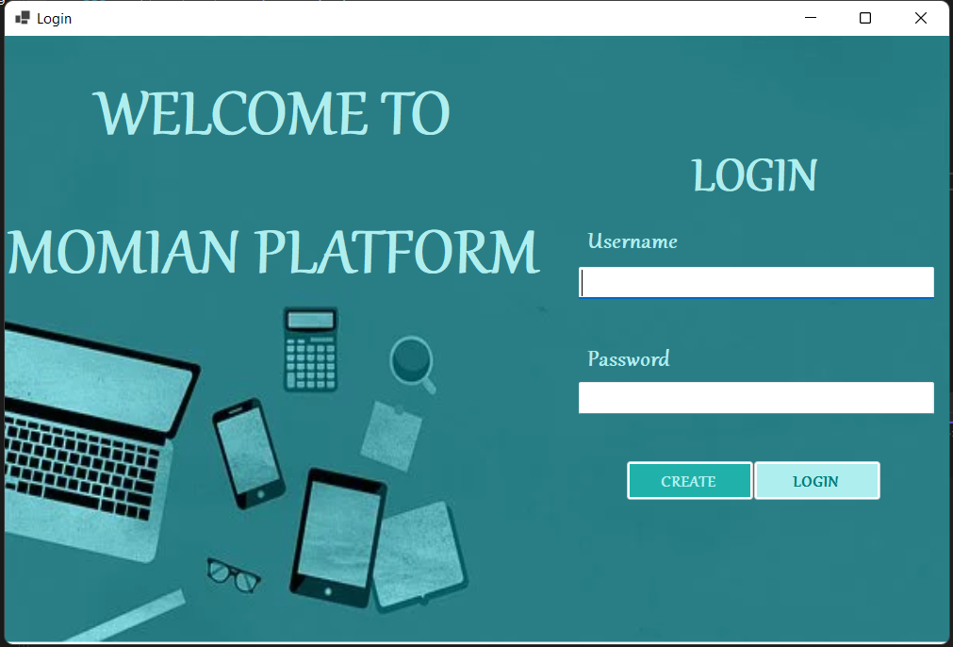
USER INTERFACE: LOGIN

Slide 13
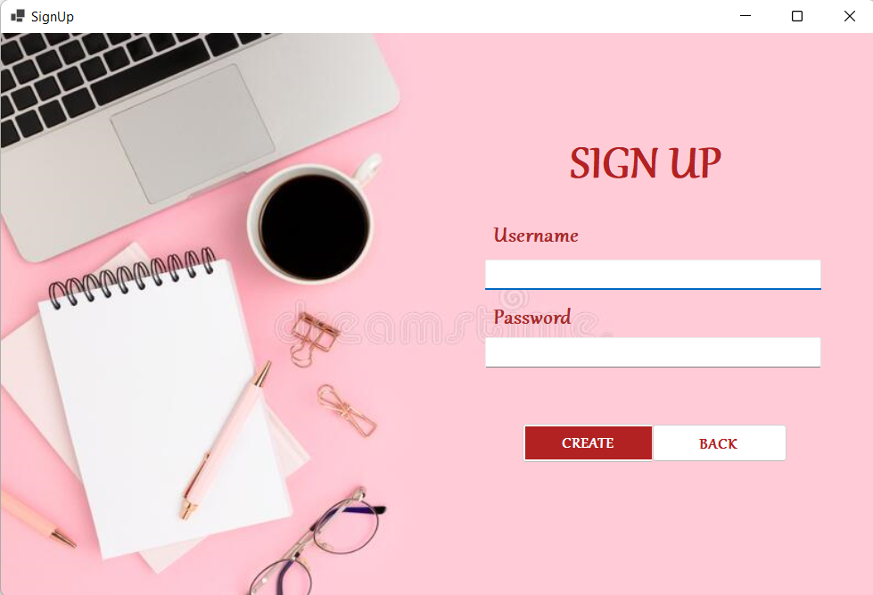
USER INTERFACE: SIGN UP

Slide 14
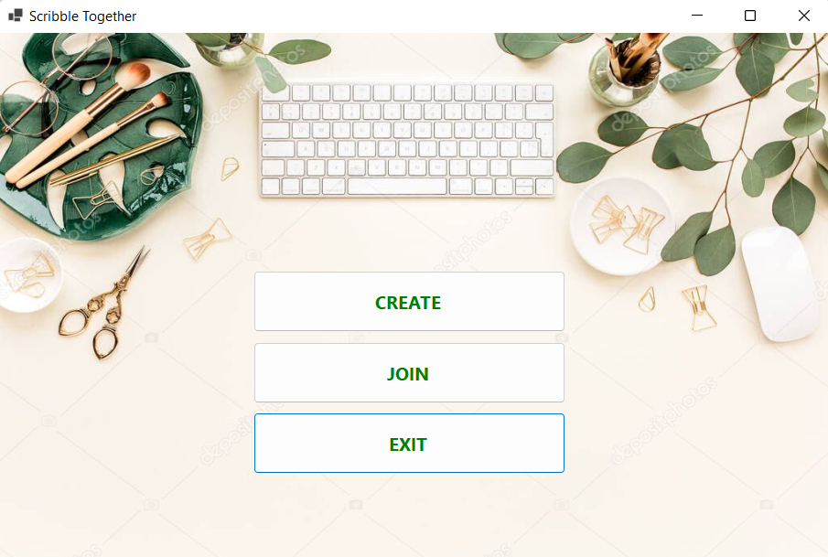
USER INTERFACE: DASHBOARD

Slide 15
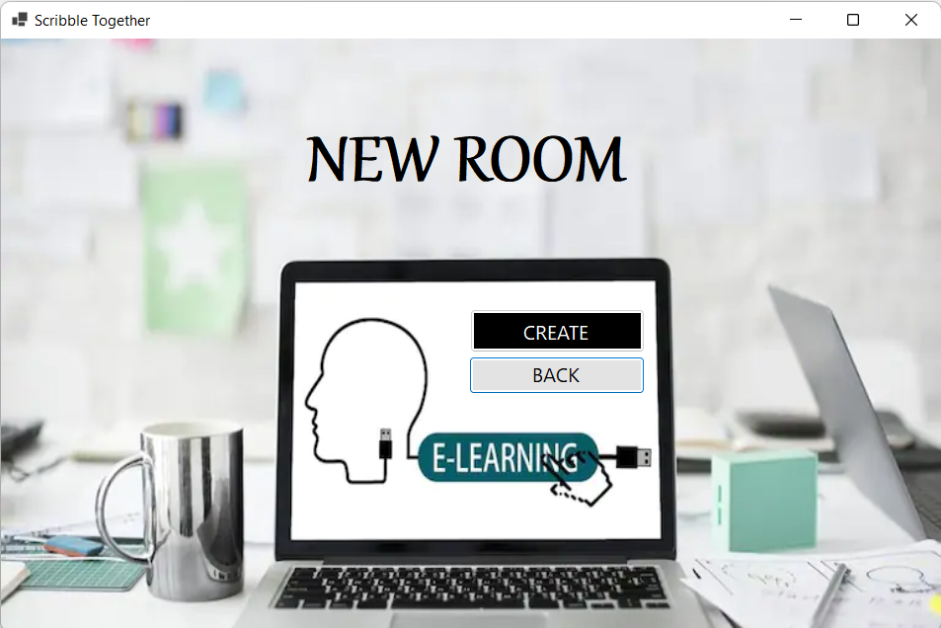
USER INTERFACE: CREATE ROOM

Slide 16
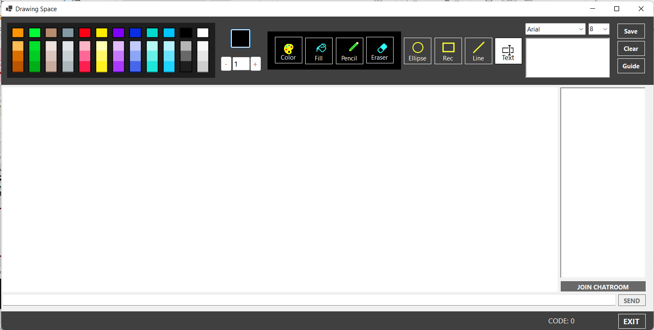
USER INTERFACE: WORKSPACE

Slide 17
USER INTERFACE: MULTI CLIENT

Slide 18

TESTING FEATURES

Slide 19
DEMO

